Slide 1
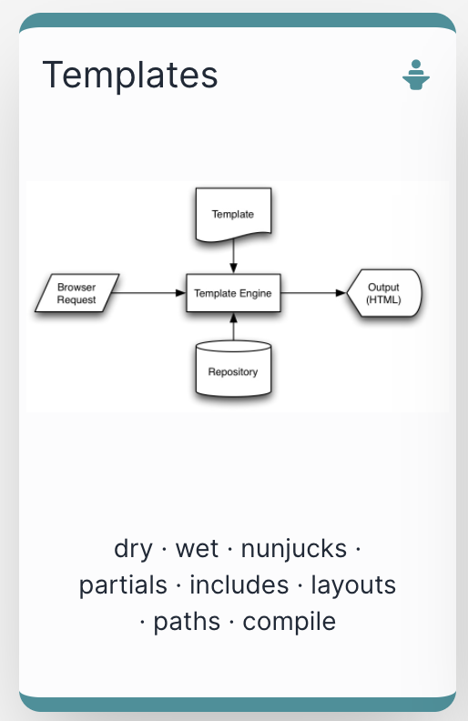

Slide 2
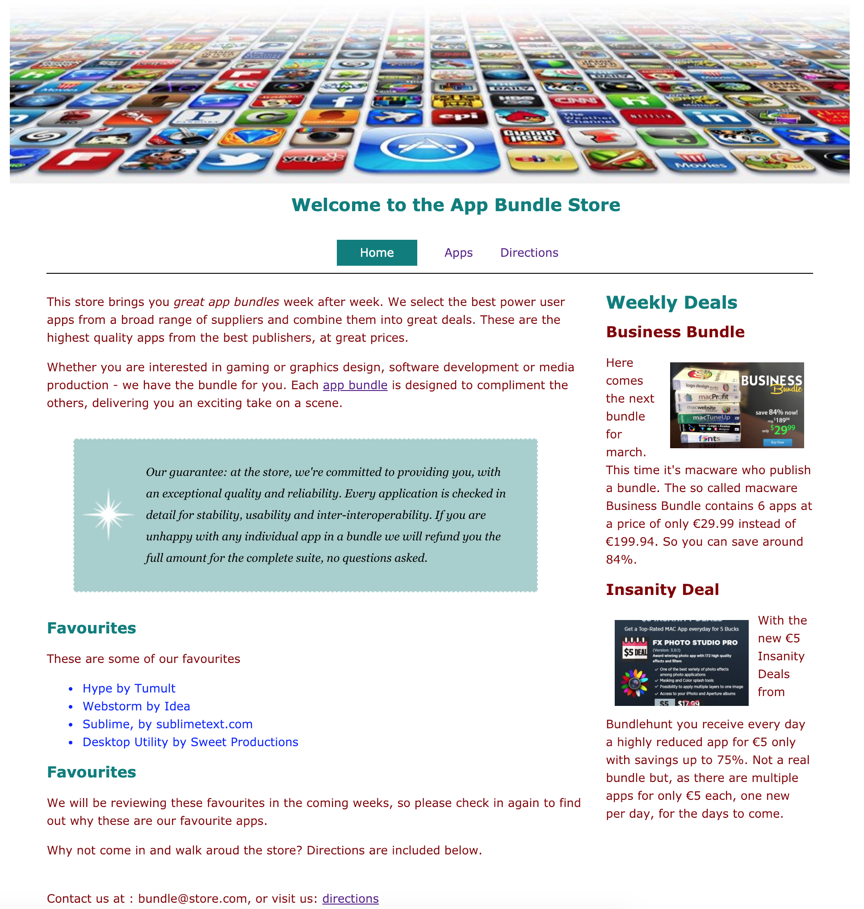
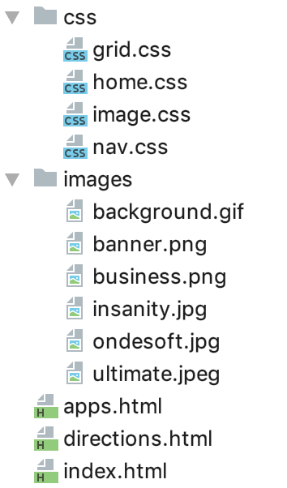

Slide 3
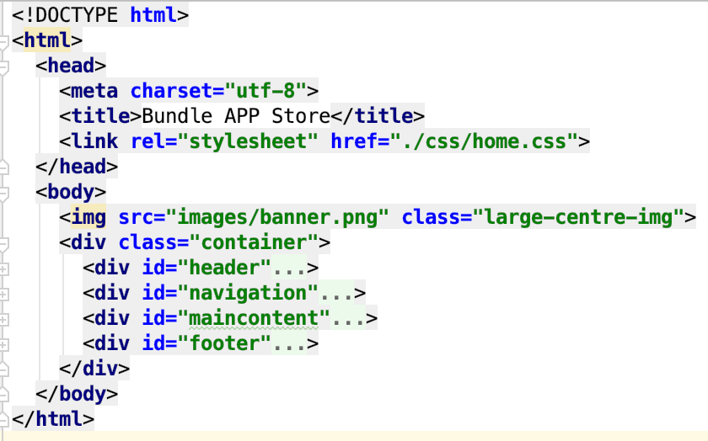
Templates Why?
This web site has 3 pages.
Each page has:
Head Section
Body Section
Each Body Section has
Header
Footer
3 Identical Head Section
3 Identical Header’s
3 Identical Footer’s
repeated sections in each file (<head> <body> etc…

Slide 4
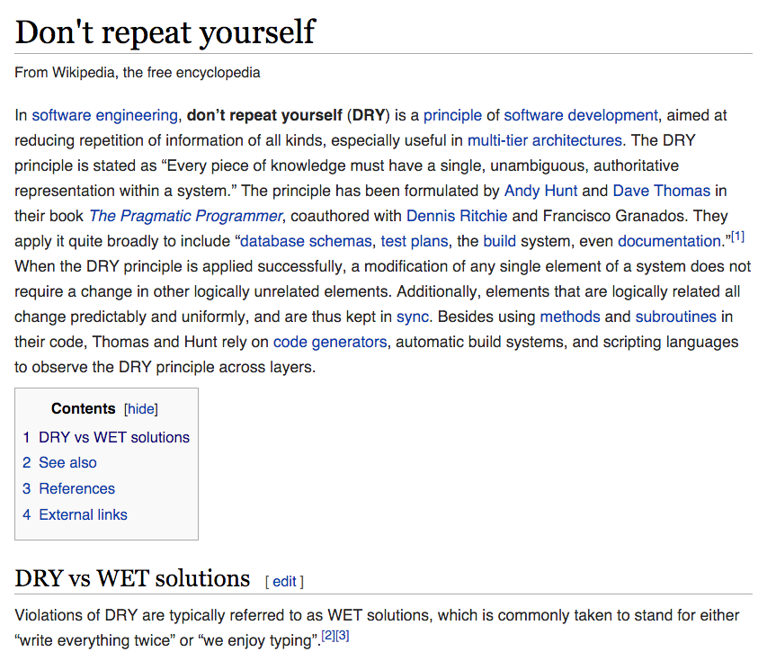
Its got its own Wikipedia Page!
https://en.wikipedia.org/wiki/Don%27t_repeat_yourself

Slide 5
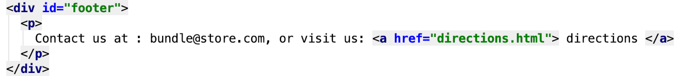
Dry vs WET
Dont Repeat Yourself
vs
Write Everything Twice
OR
We Enjoy Typing

Slide 6
Dry: Single Header + Footer Template
Incorporate the SAME single header/footer in all pages
Any updates made once to single header/footer

Slide 7
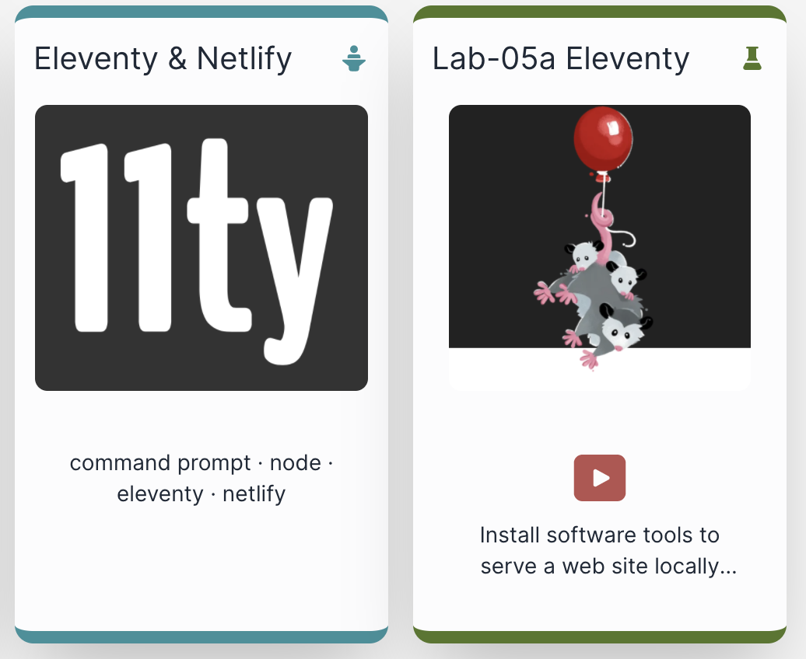
Web Template System
“A web template system uses a template processor to combine web templates to form finished web pages, possibly using some data source to customize the pages or present a large amount of content on similar-looking pages. It is a web publishing tool present in content management systems, web application frameworks, and HTML editors.”
https://en.wikipedia.org/wiki/Web_template_system

Slide 8
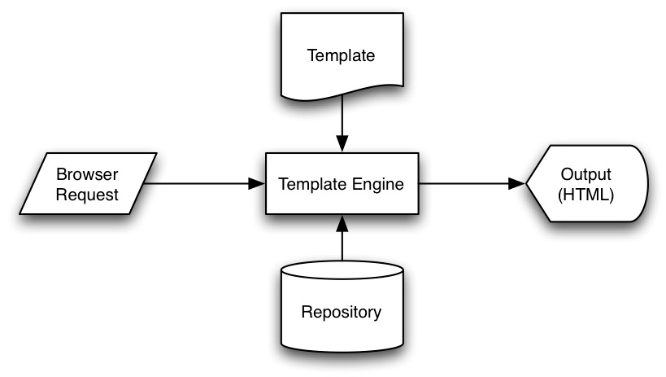

Slide 9
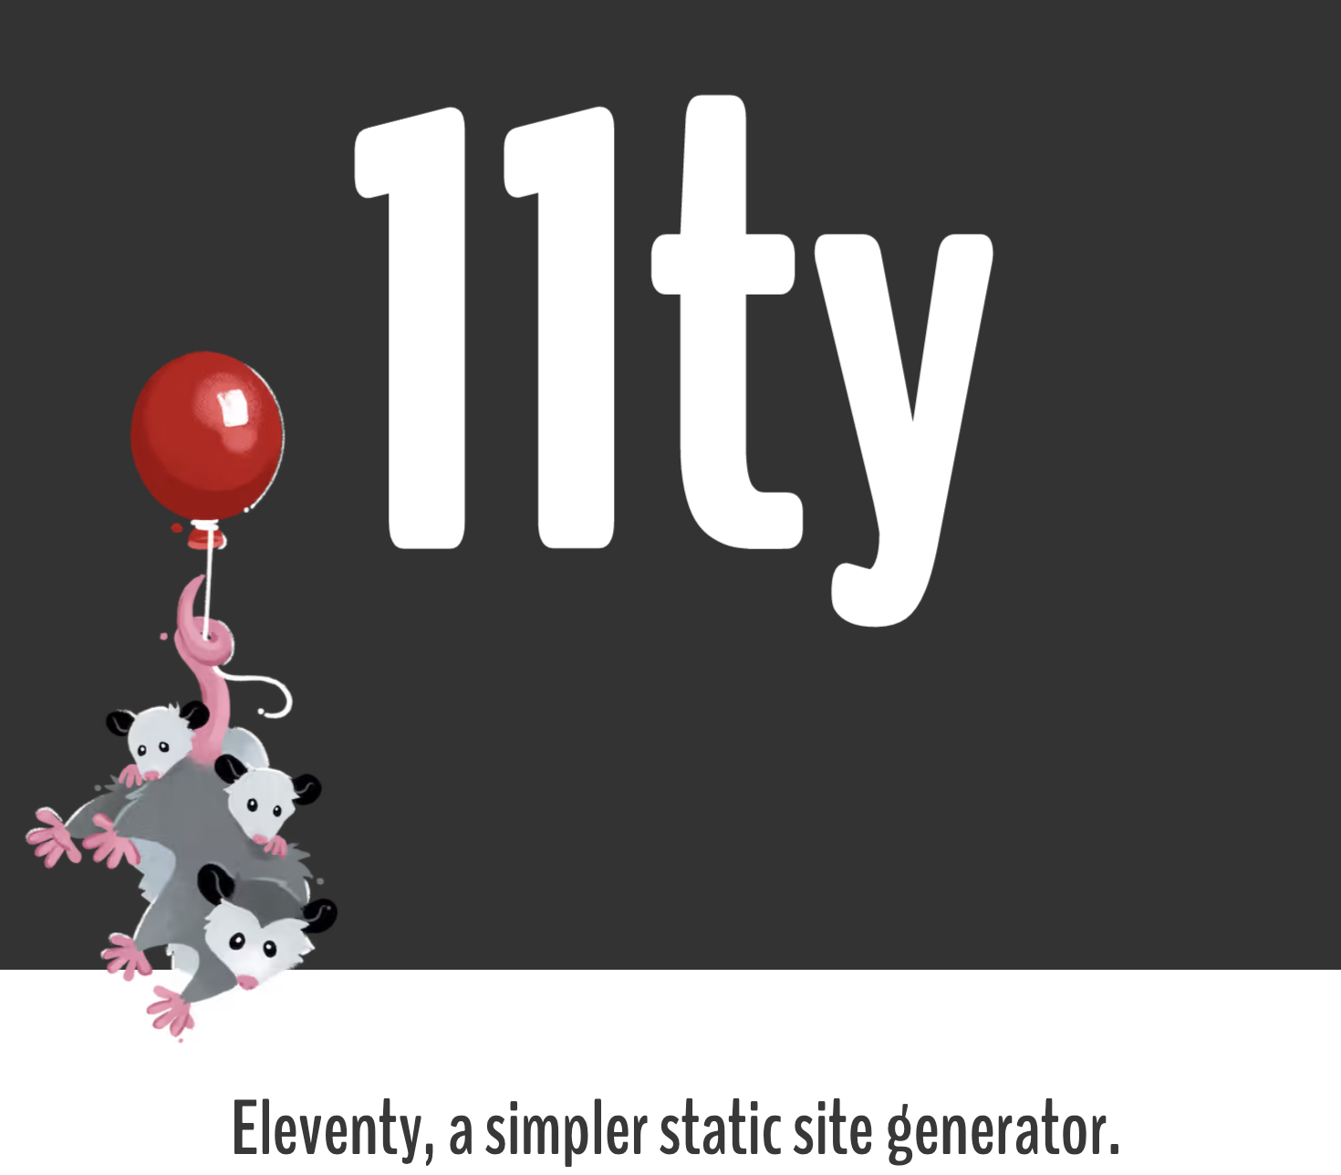
Eleventy
Eleventy includes Template Engines
It ‘serves’ the site
If Request is for ordinary page the page is ‘rendered’ without modification
If Request is for a page that is composed of templates, harp assembles the page and renders the complete page to the browser

Slide 10
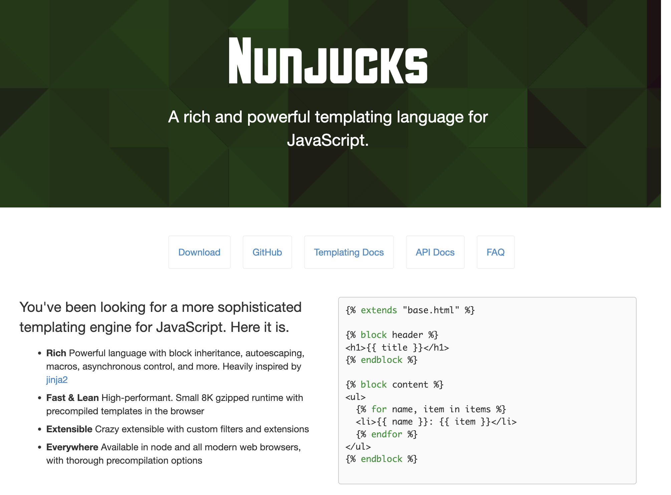
Templating Engine used by 11ty (one of several alternatives)
We need just a small subset of its features:
Layouts
Includes
Rename files:
.html -> .njk

Slide 11
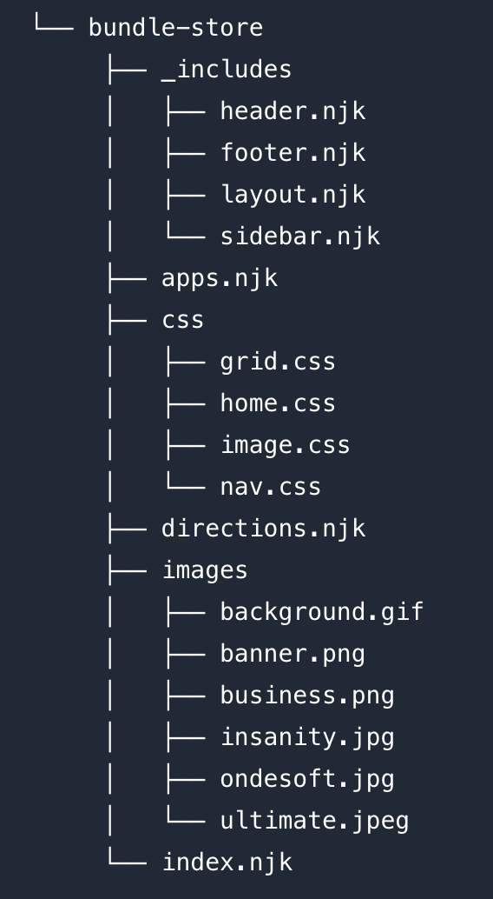
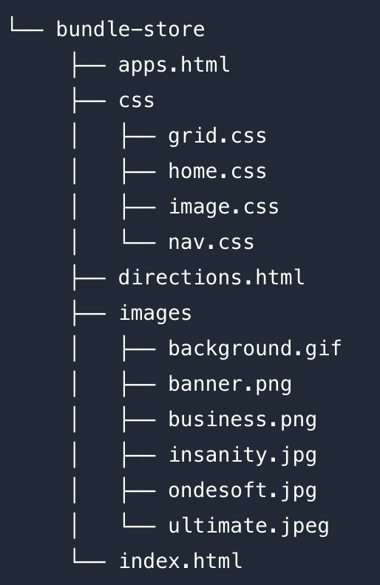
DRY Version
Overall - more files, but less content
WET Version
Reusable templates (partials & layout) included in various pages
No change to CSS
Reworked using templates

Slide 13
layout.njk

Slide 14
layout.njk
header.njk
index.njk
sidebar.njk
footer.njk

Slide 15
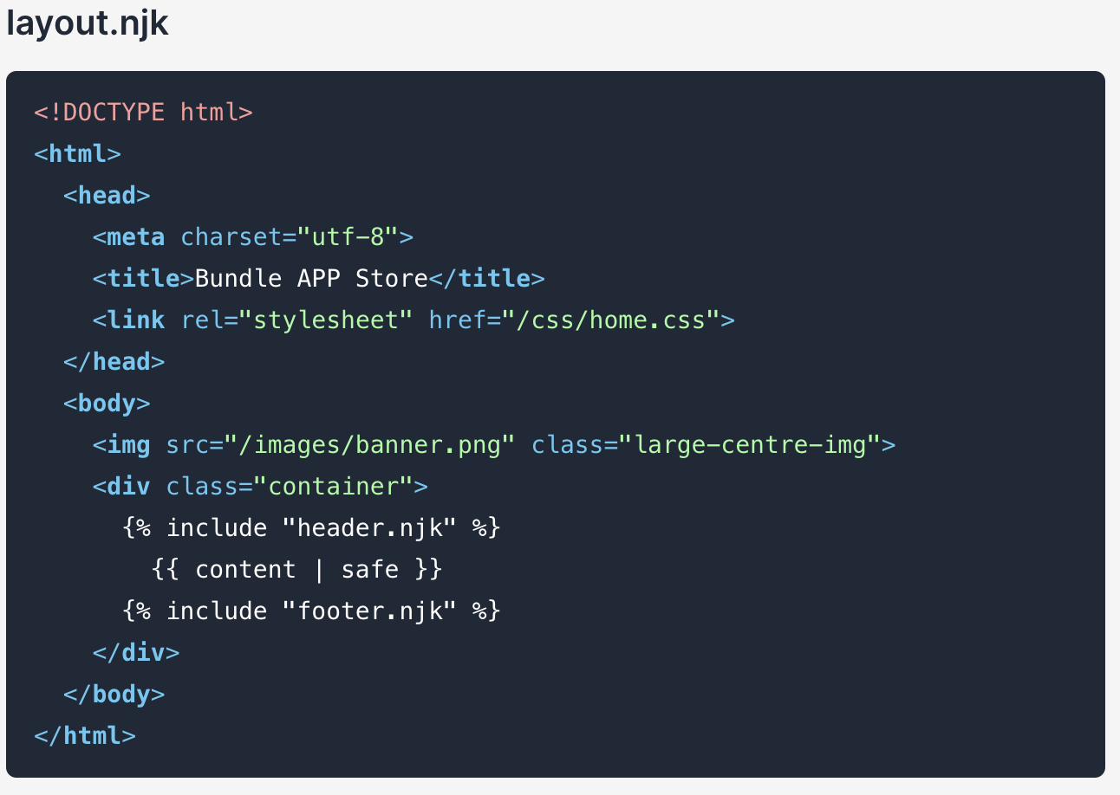
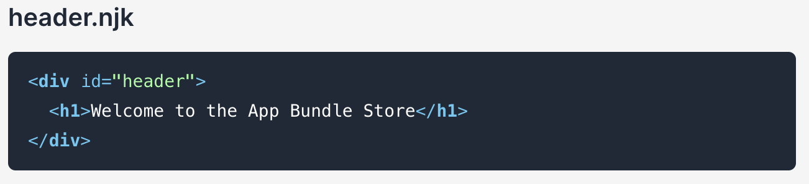
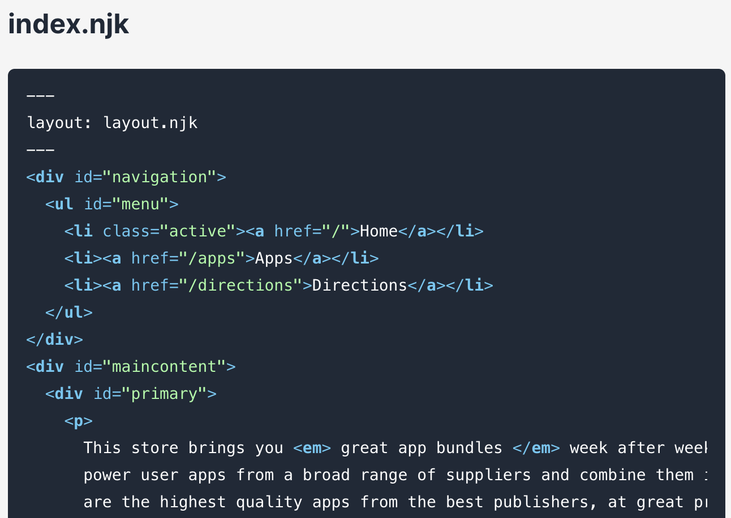
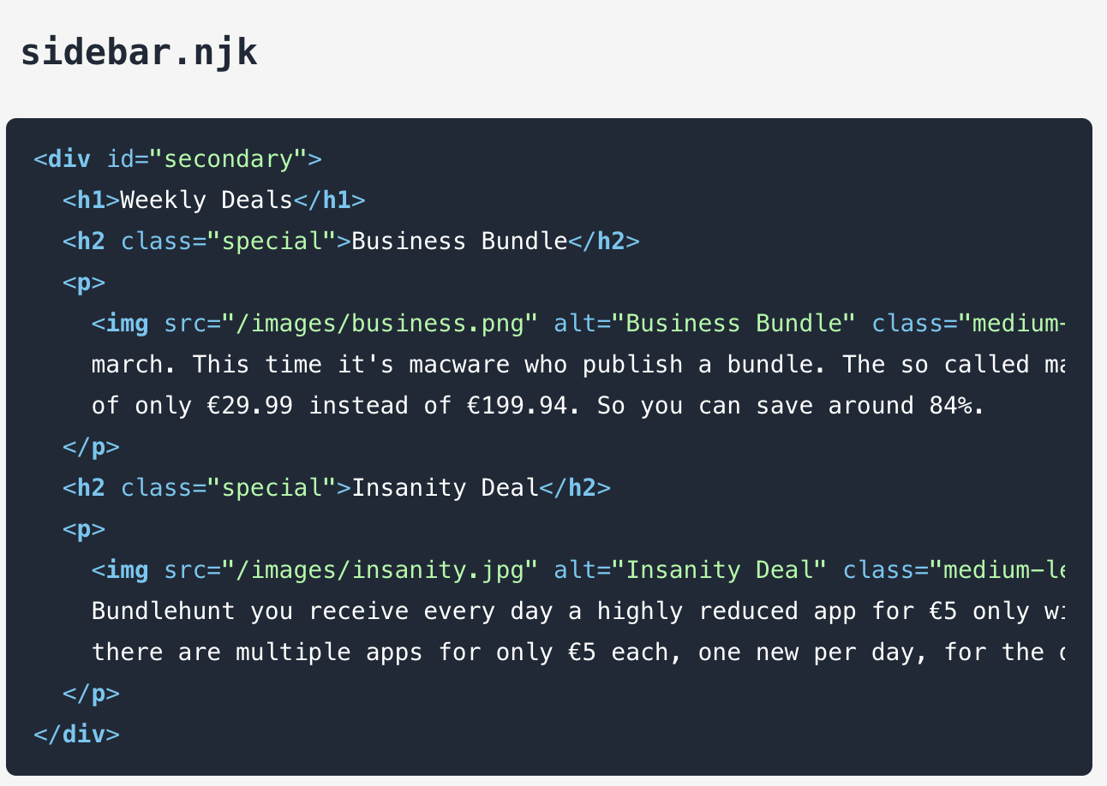
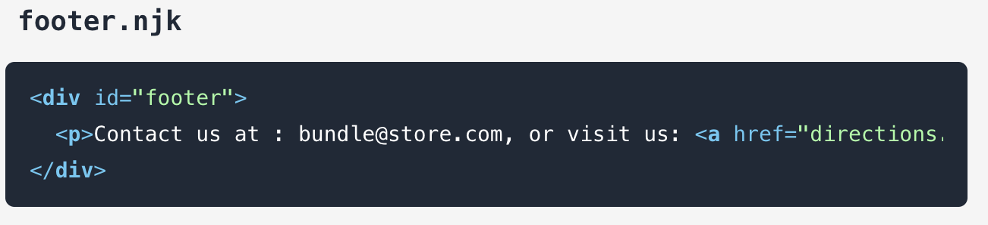
layout.njk
header.njk
index.njk
sidebar.njk
footer.njk

Slide 16
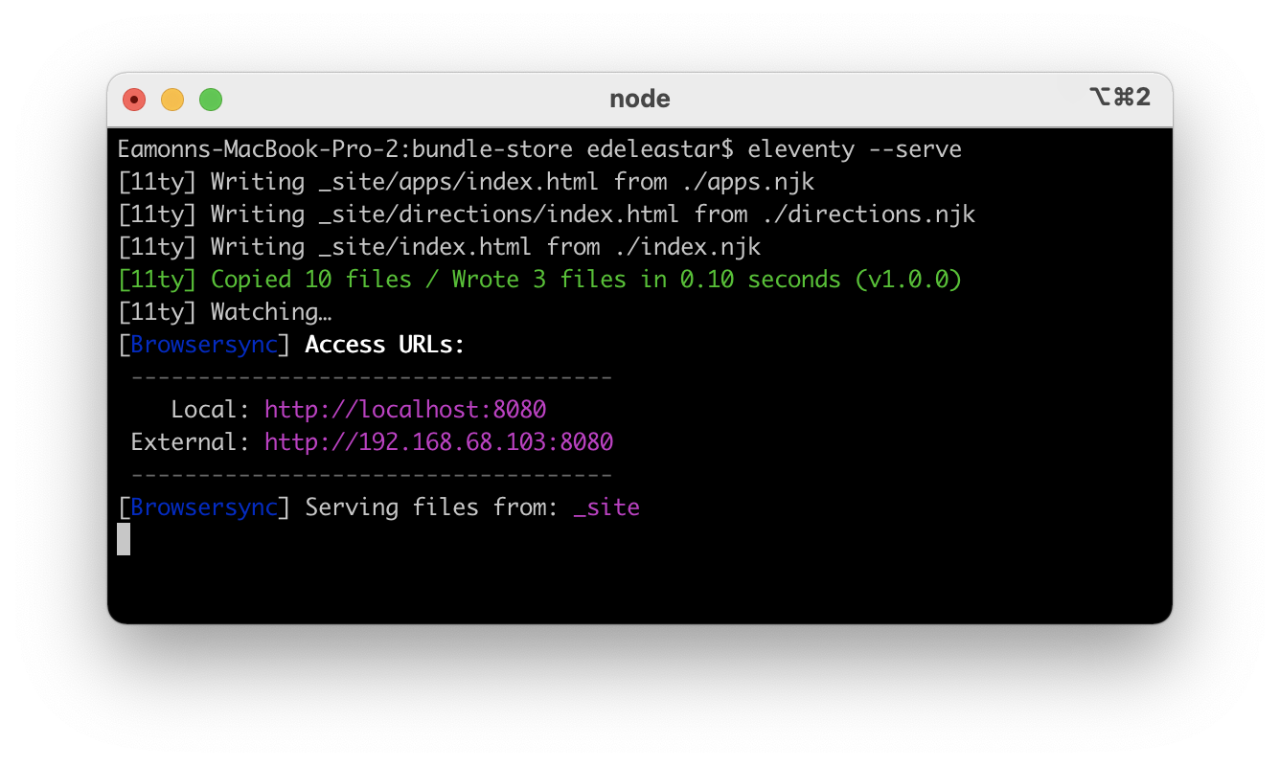
Server must be started:
“eleventy —serve”
Start Server
Server can also be stopped:
Ctrl-C
Site now available here
(when server is started)
http://localhost:8080/

Slide 17
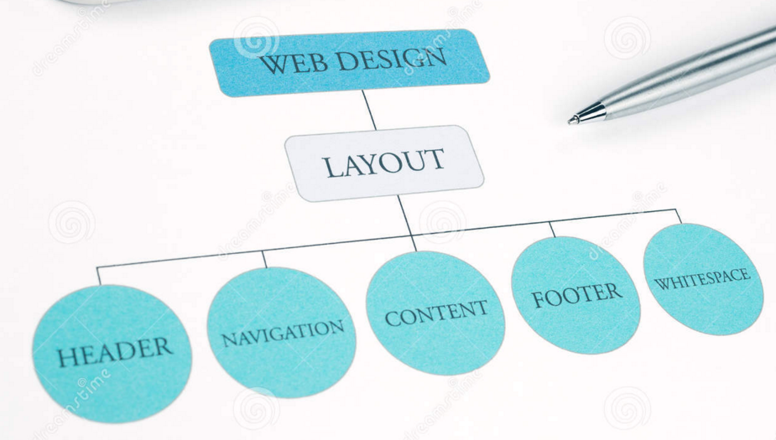
Layouts
Layouts are another powerful mechanisms for adopting a DRY approach
With Layouts, we can define the structure of the overall page…
… and each page that uses the layout substituting into a specific part of the page

Slide 18
Layouts
Include header & footer ‘partials’
Pages can choose to be based in this ‘layout’.
Page content will be inserted here

Slide 19
Partials
Reusable fragments of html.
Can be ‘included’ in any other partial, layout or template

Slide 20
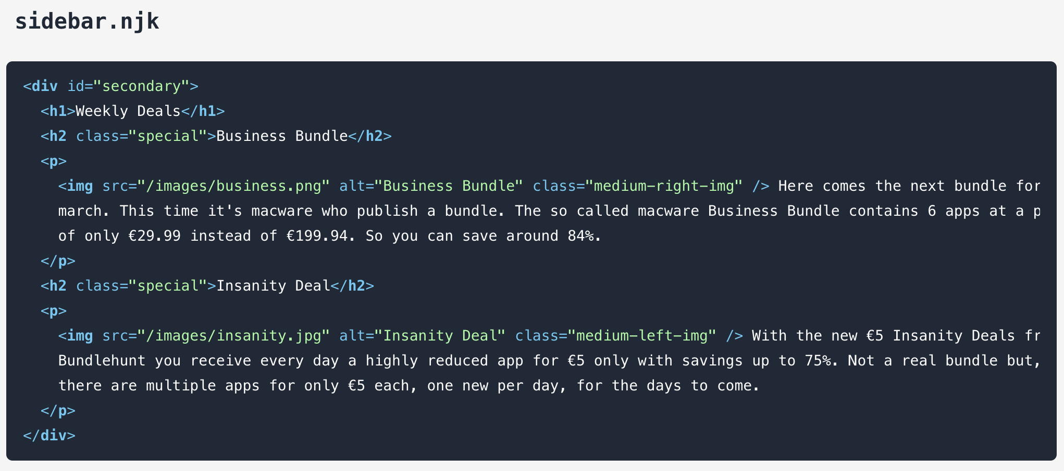
Partials

Slide 21
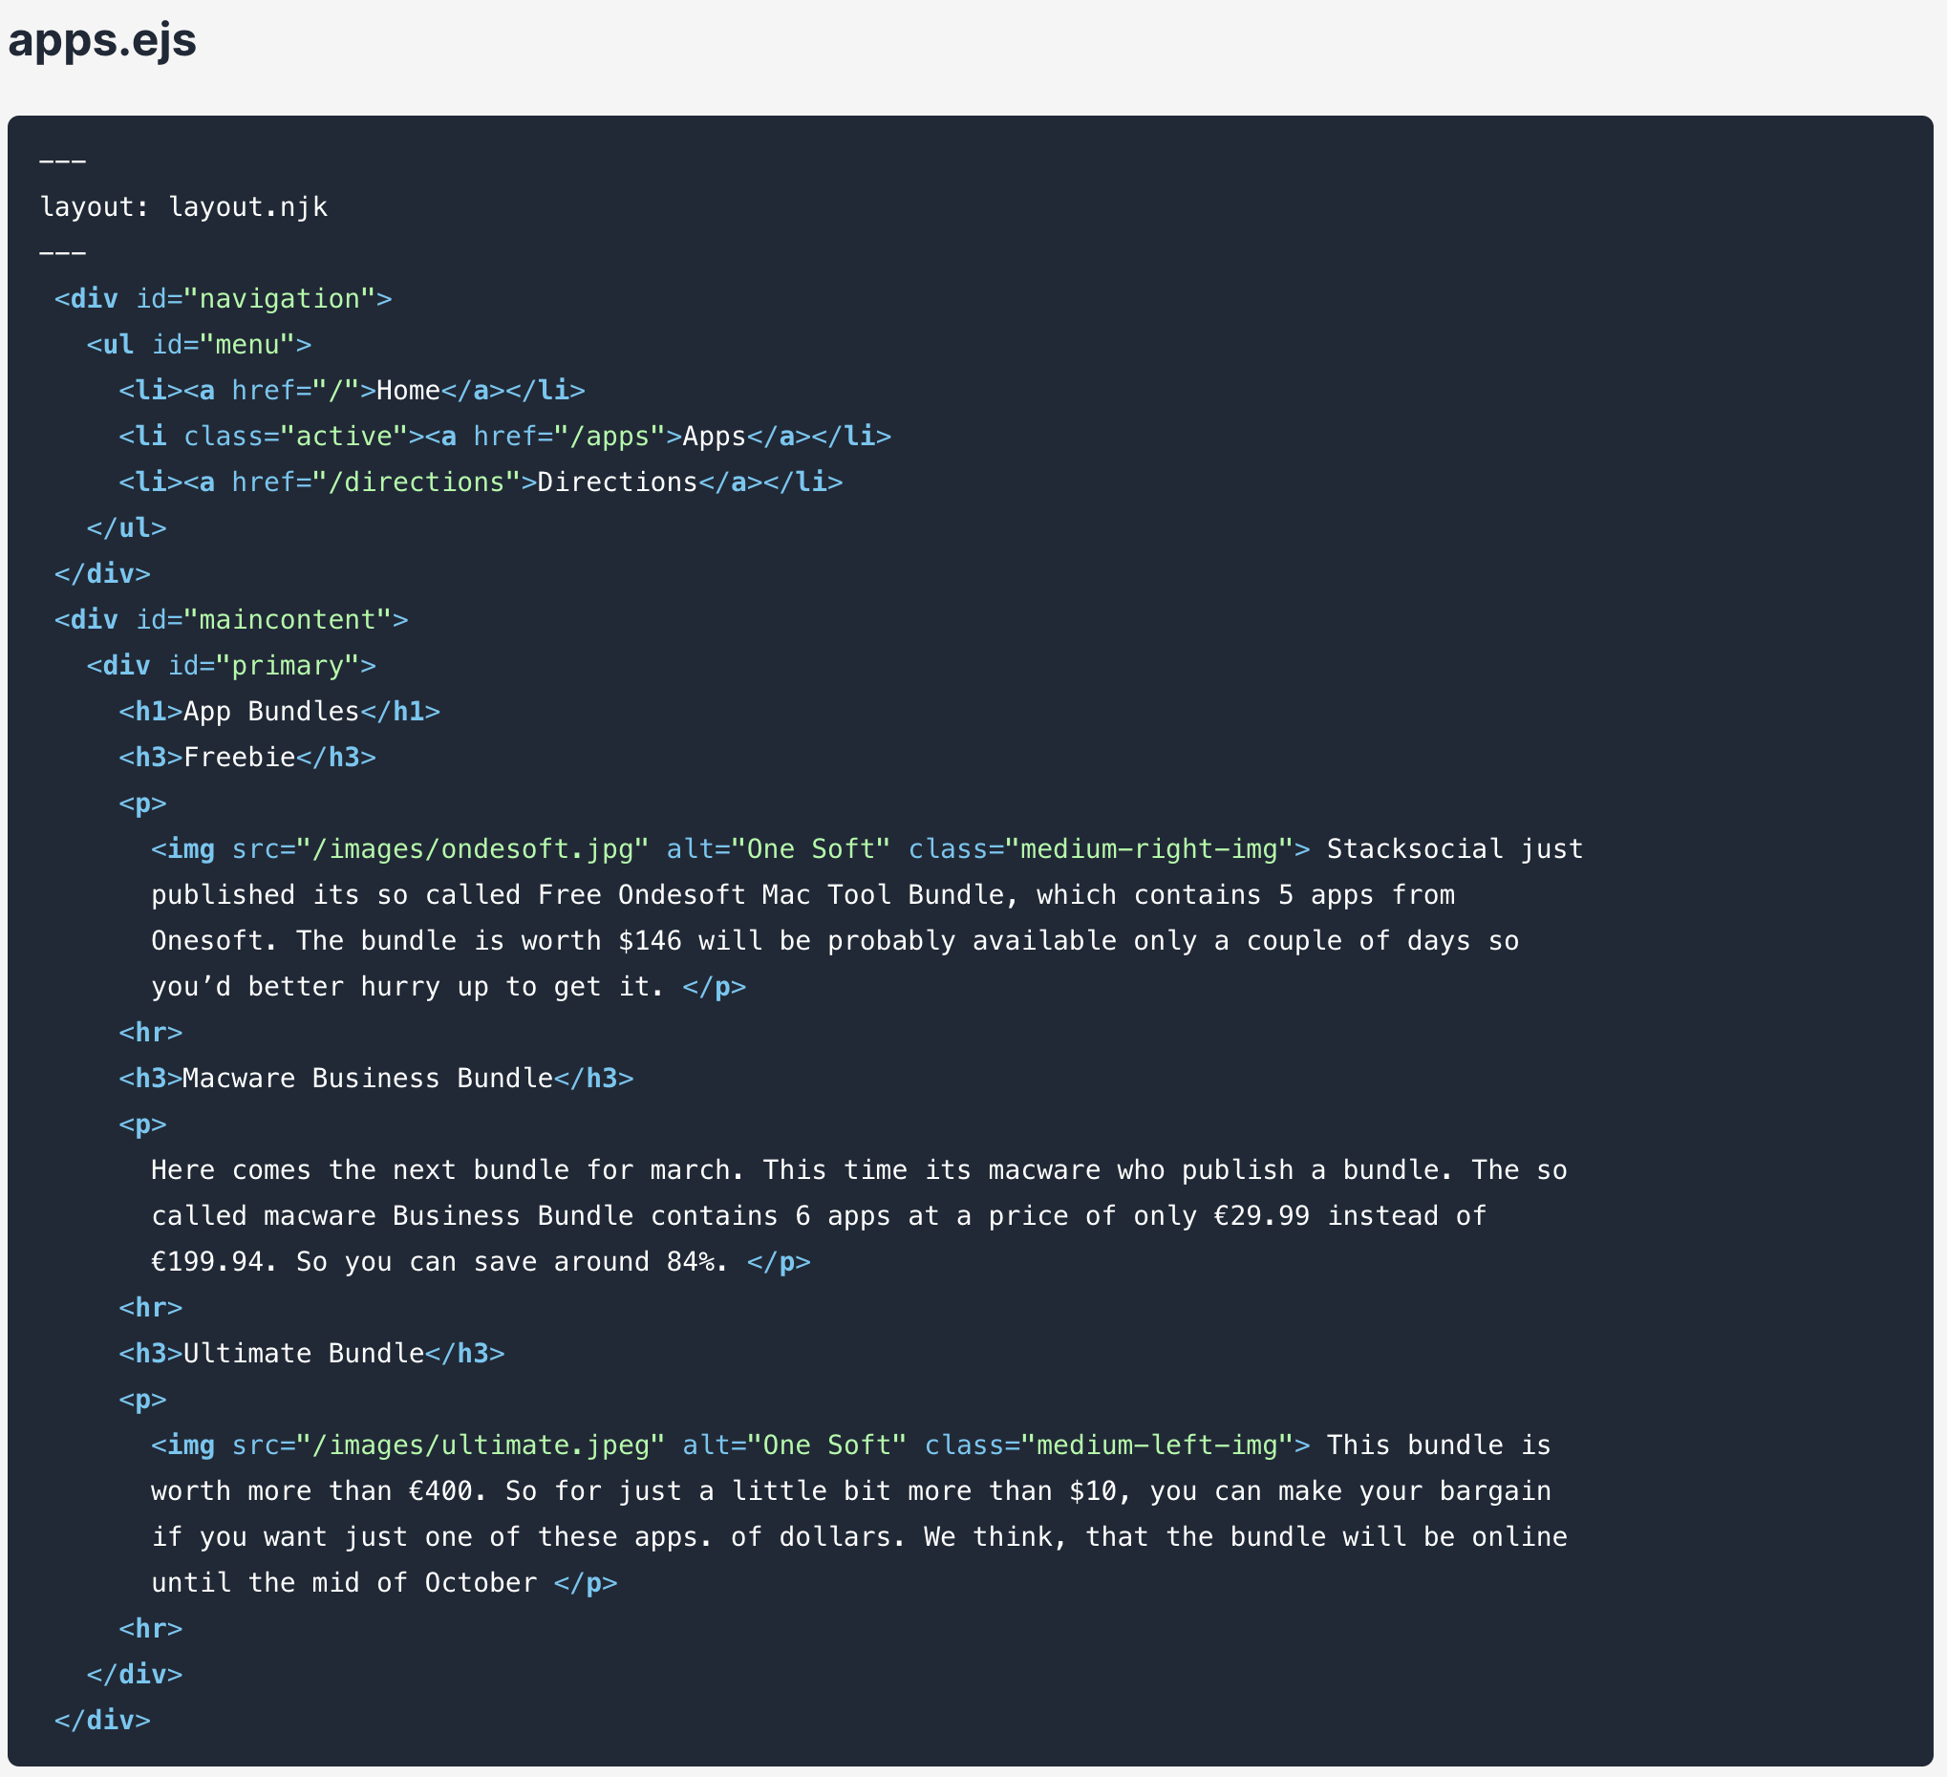
This template will be laid out using this a layout.
Page content does not need header section, body etc… as these are all defined in layout
Templates

Slide 22
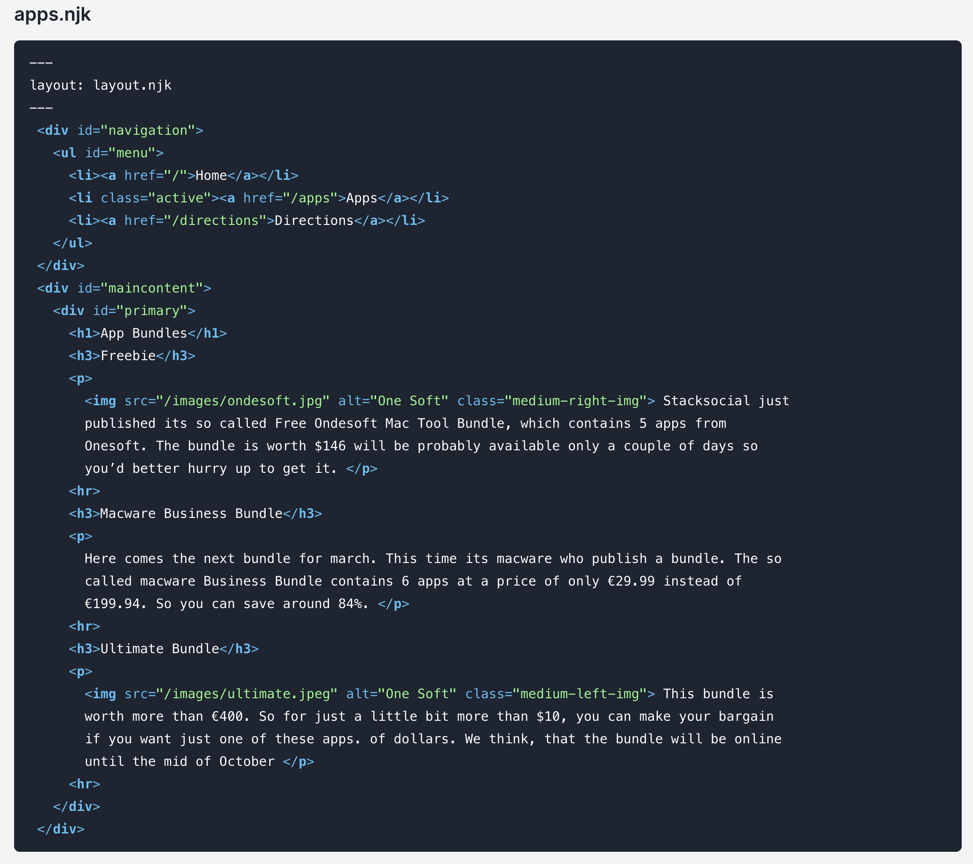
Templating System

Slide 23
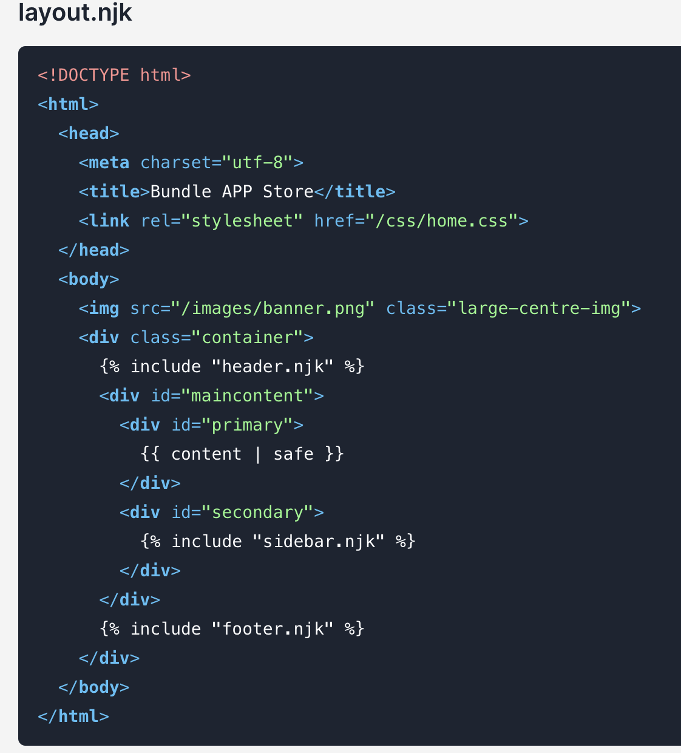
Enhanced Layout

Slide 24
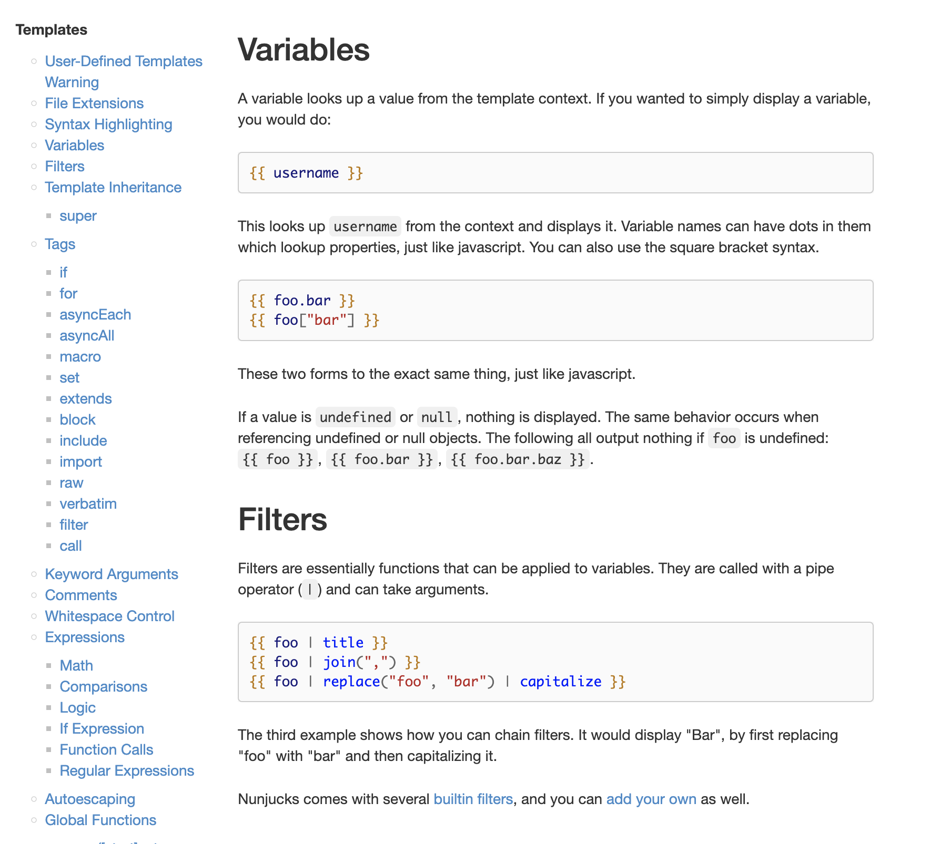
Nunjucks is a complete system for ‘programming’ inside a template

Slide 25

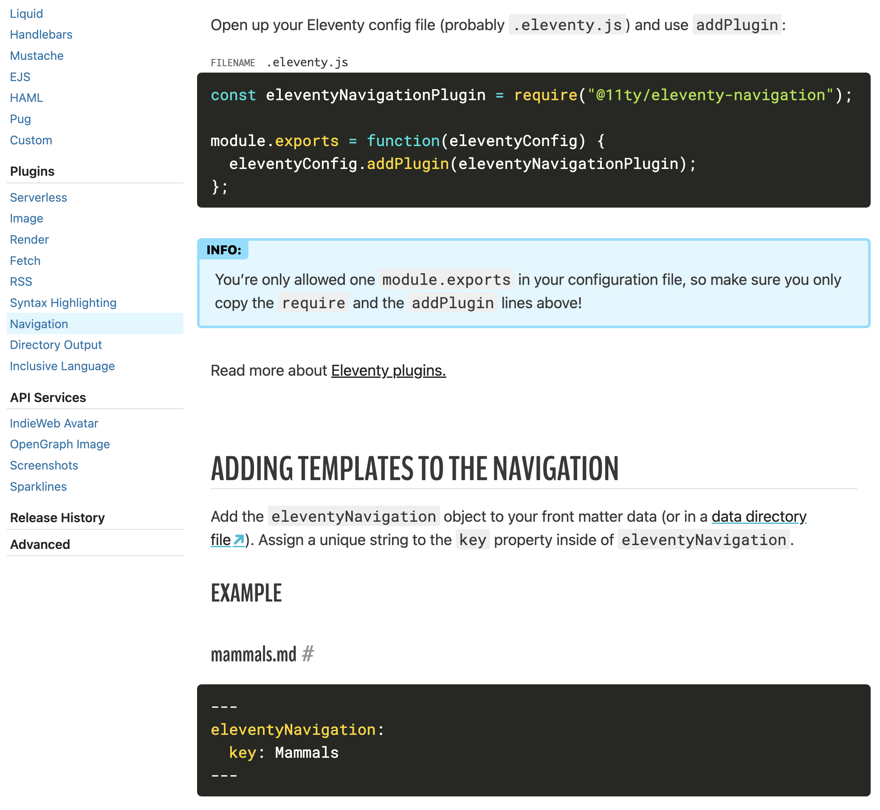
11ty has a range of plugins and extensions to enhance the productivity of web site development
Navigation is a key feature available as a plugin

